Slide 1
Infant and Perinatal Mortality in the Yorkshire & the Humber
Yorkshire and the Humber Local Knowledge and Intelligence Service
PHE Yorkshire and the Humber

Slide 2
Contents
Aims 3
Definitions 4
Infant mortality in Yorkshire and the Humber 5
Risk factors contributing to infant mortality 10
Low birth weight 11
Smoking at time of pregnancy 12
Teenage pregnancy 13
Breastfeeding initiation 14
Deprivation 15
Maternal age 16
Mothers country of birth 17
Conclusion 18
Limitations 29
Acknowledgements 20
Appendices (Mortality rates by local authority over time) 22

Slide 3


Aims
The purpose of this report is to:
Provide a snapshot of infant and perinatal mortality in the Yorkshire & the Humber
Present a descriptive analysis of the risk factors and health inequalities which may impact on infant and perinatal mortality
Offer an impetus for further detailed analysis in individual local authority areas
This report is intended for those working in:
      local authorities
      the NHS
      voluntary sector fields.

Slide 4
Definitions
Stillbirth | A baby delivered at or after 24 weeks of gestational age showing no signs of life, irrespective of when the death occurred. The stillbirth rate is calculated per 1,000 total births (both live and stillbirths)
Neonatal Mortality | Number of deaths of infants at ages under 28 days. Neonatal mortality can be divided into Early Neonatal mortality (deaths up to 6 days after live birth) and Late Neonatal mortality (deaths from 7 days but under 28 days after live birth). The neonatal mortality rate is calculated per 1,000 total live births
Perinatal Mortality | Perinatal Mortality: Includes stillbirths (after 24 weeks gestation) and deaths of early neonates (aged less than 7 complete days). The perinatal mortality rate is calculated per 1,000 total births (both live and stillbirths)
Infant Mortality | Number of deaths of infants aged less than 1 year excluding stillbirths
Low Birth Weight | Number of live and stillbirths occurring in the respective calendar year at under 2500 grams for all maternal ages. The proportion is calculated as a percentage of all live and stillborn infants.

Slide 5
Infant mortality in Yorkshire & the Humber
Infant mortality in Yorkshire & the Humber has improved significantly over the last 15 years in line with national trends
Infant mortality in Yorkshire & the Humber is significantly worse than the England average (4.3 per 1000 compared to 3.9 per 1000)
574 babies died before birth or before the age of 1 in Yorkshire and the Humber in 2015
The rate of still births in Yorkshire and the Humber is similar to that for England (non-significant)
There were 287 still births in Yorkshire and the Humber in 2015
There is wide variation in both infant mortality rates and still birth rates between local authorities in Yorkshire and the Humber

Slide 6
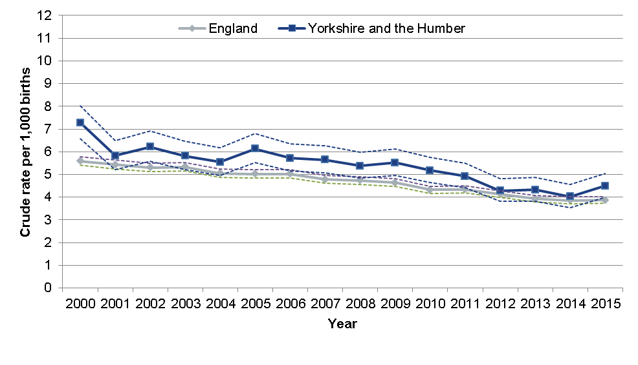
Infant mortality
Around 4.5 in 1000 babies born in Yorkshire and the Humber die before the age of 1 (2015) We have seen a significant improvement since 2000

Slide 7
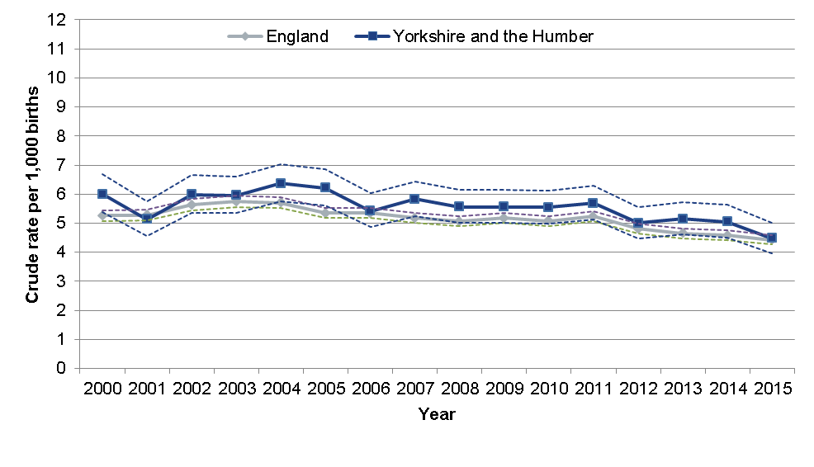
Still Births
5 in 1000 babies born in Yorkshire and the Humber are stillborn, this is similar to the England rate

Slide 8
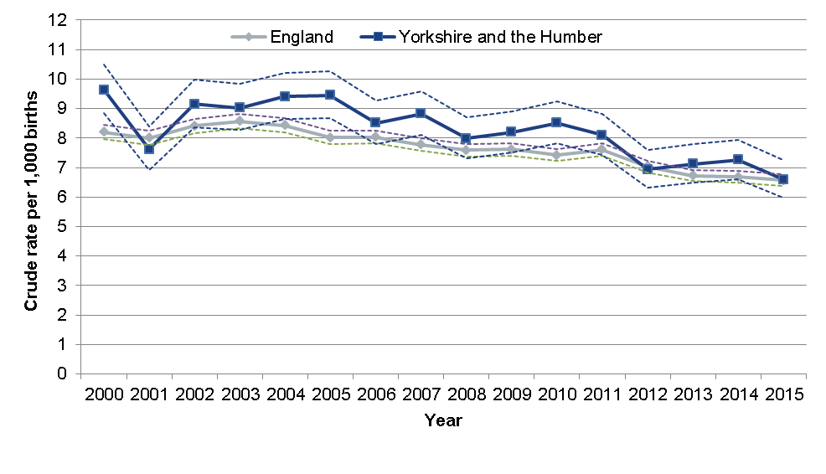
Perinatal mortality
7 in 1,000 babies born in Yorkshire and the Humber die in the perinatal period. There has been significant improvement in this rate since 2000

Slide 9
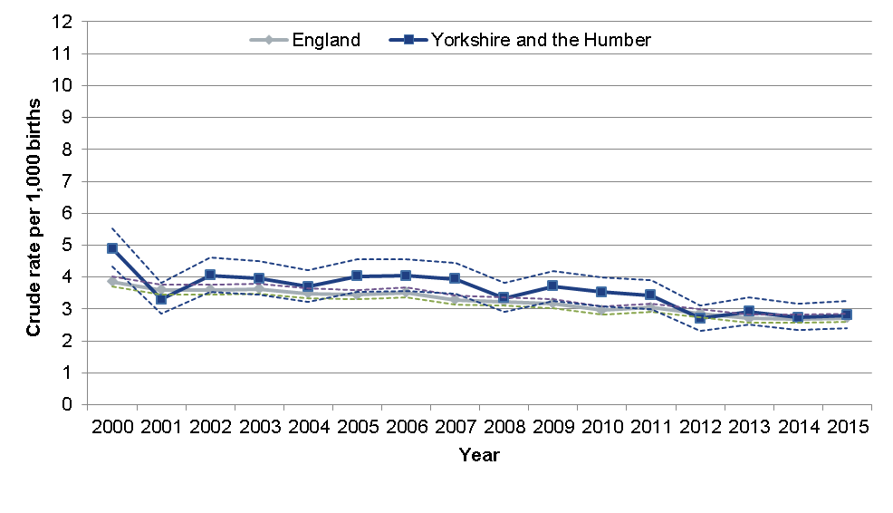
Neonatal mortality
3 in 1,000 babies born in Yorkshire and the Humber die before 28 days of life

Slide 10
Factors contributing to Infant mortality

Slide 11
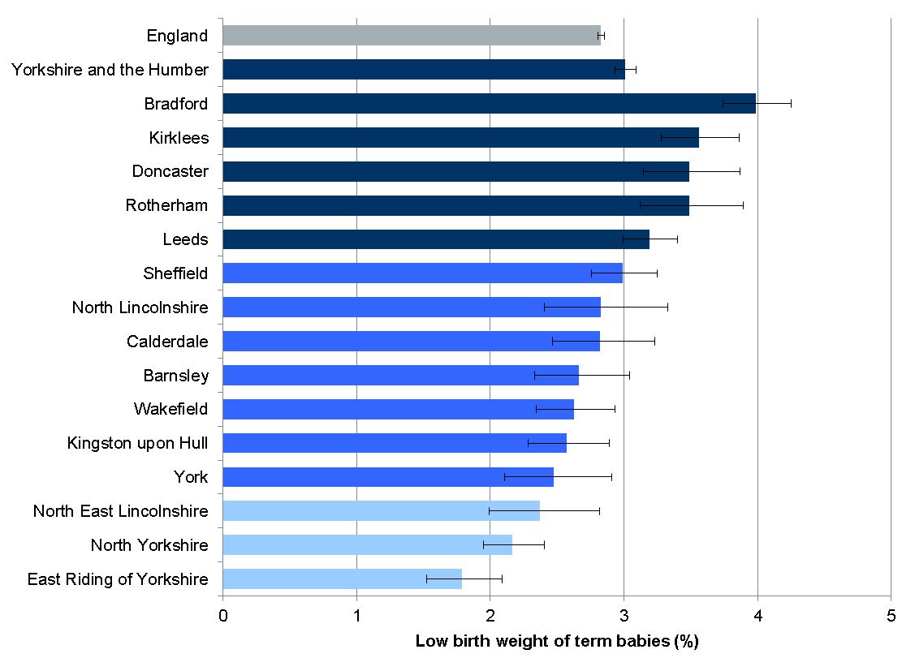

Low birth weight
3% of babies born in Yorkshire and the Humber weigh less than 2,500g (2012-14)

Slide 12
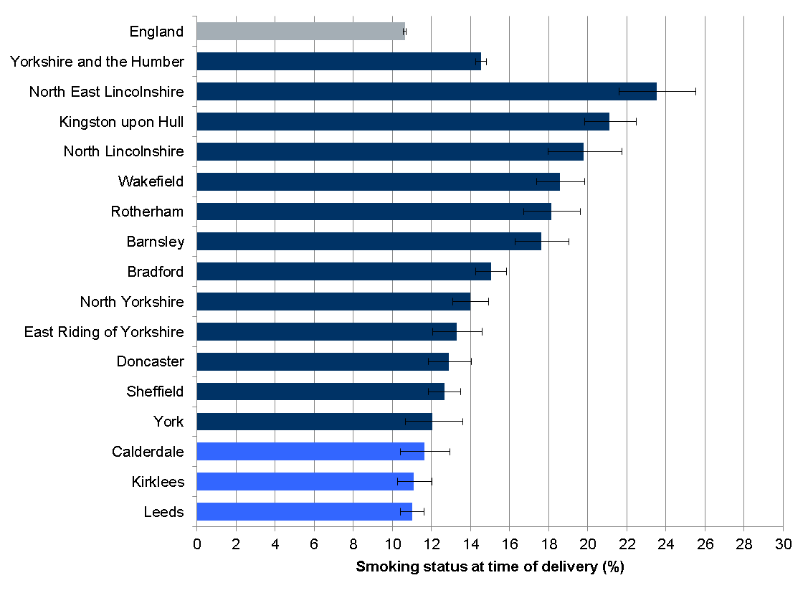
Smoking at time of pregnancy
14% of mothers in Yorkshire and the Humber report smoking at the time of delivery (2015-16)

Slide 13
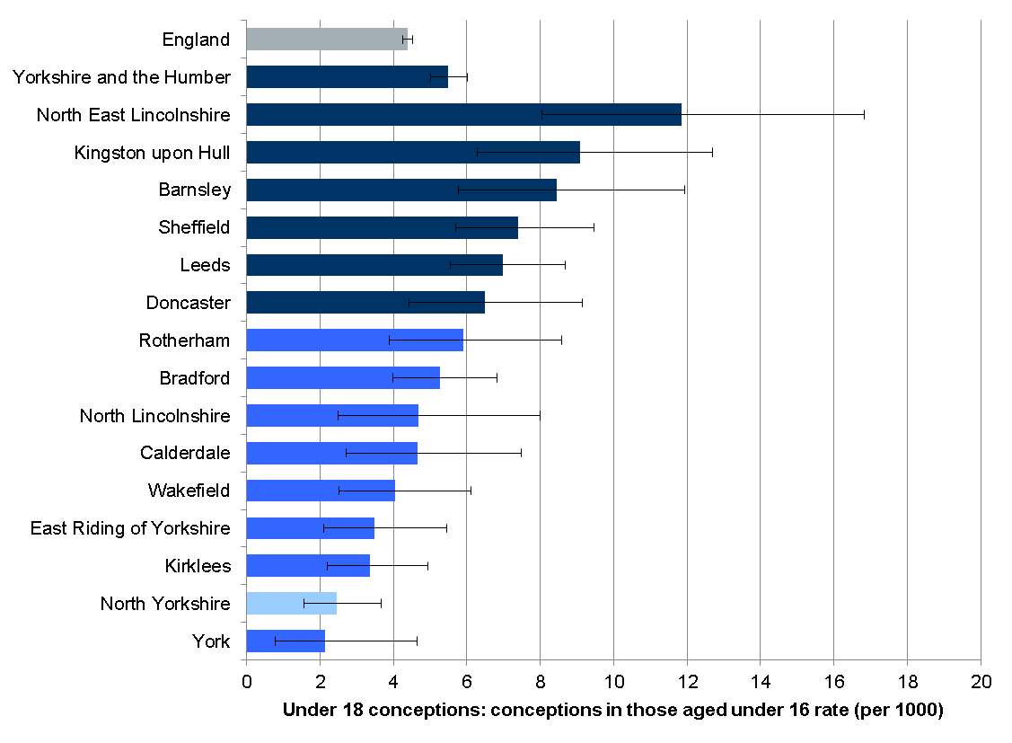
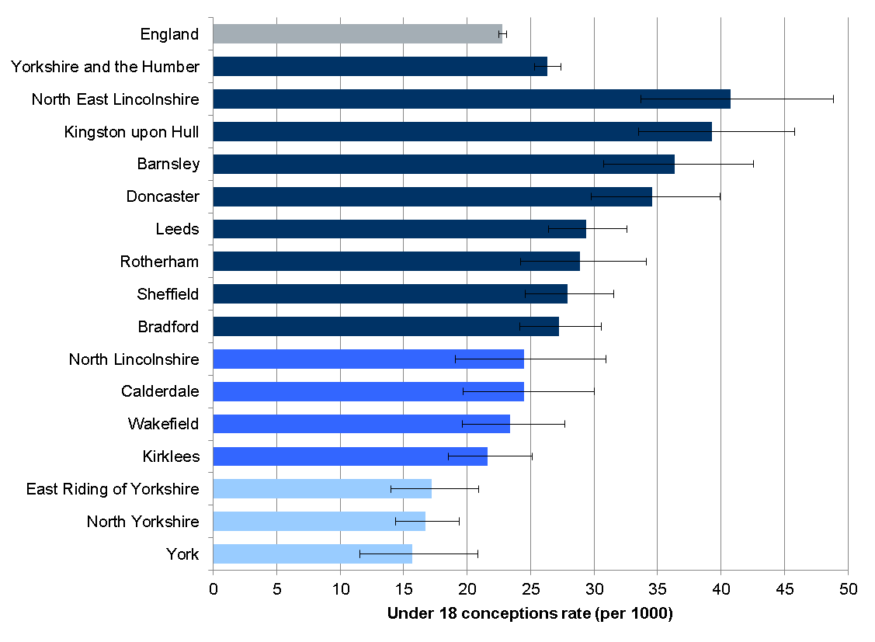
Teenage pregnancy
5 conceptions per 1000 population are in girls aged 13 to 15 years (2014)
This increases to 26 conceptions per 1000 girls aged 15 to 17 years (2014)

Slide 14
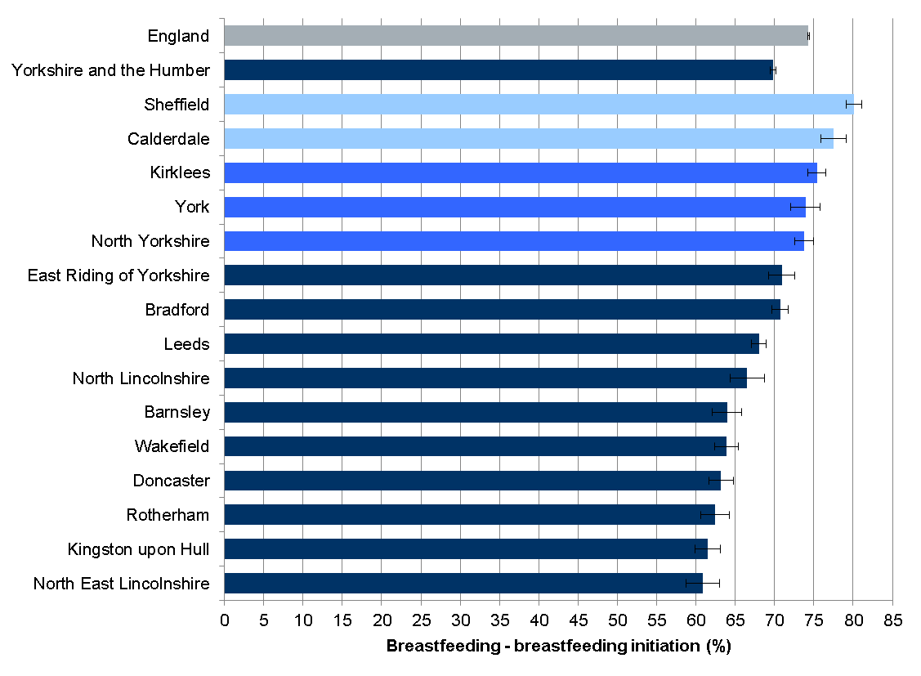
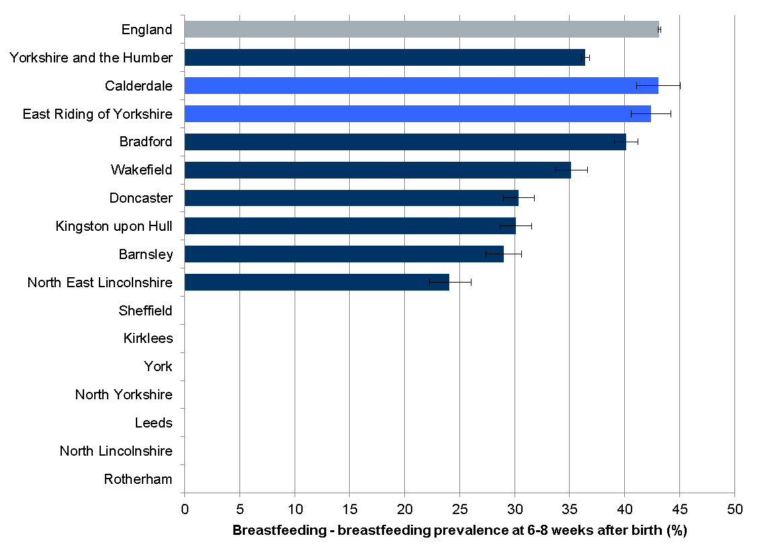
Breastfeeding
70% of mothers in Yorkshire and the Humber initiate breast feeding in the first 48 hours of delivery (2014-15)
But only 36% half are breast feeding after 6-8 weeks (2014-15)
Data missing due to data quality issues

Slide 15
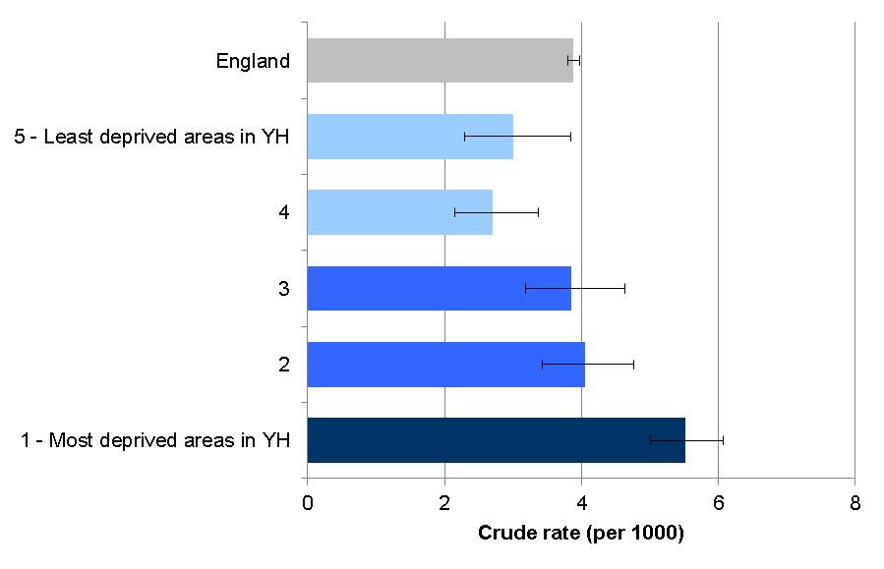
Deprivation in Yorkshire and the Humber
There is significant variation in infant deaths between the most and least deprived areas in Yorkshire and the Humber. 32% of infant deaths could potentially be avoided if mortality rates were identical to those in the least deprived areas

Slide 16
Maternal age
Evidence suggests younger (under 20 years old) and older maternal ages (mothers aged 40 or older) have a higher risk of infant death
Boxplot of Maternal age of birth registered in 2012-2014
NB The circles in the boxplot (Figure 18) indicate the suspected outliers

Slide 17
Mother’s country of birth
Mothers born in Pakistan but giving birth in Yorkshire and the Humber have a significantly higher (p<0.01) proportion of still births than mothers born in the UK

Slide 18
Conclusion
Infant mortality remains a key health outcome for infant and child health
Infant mortality in Yorkshire and the Humber is worse compared to the England average
There have been some improvements in infant and perinatal mortality in Yorkshire and the Humber over time, in line with the national rate
Unacceptable variation and health inequalities remain across local authorities
Priority should continue to be given to early years support, including infant and maternal health
Partnership working between the NHS, local authorities and other local bodies will continue to strengthen a shared understanding of the factors shaping infant and perinatal mortality and improved engagement with local communities

Slide 19
Limitations
Linked data between the underlying factors and mortality are currently not available
This challenge could be overcome through close collaboration with key partners and stakeholders which hold this detailed level of information.
Lack of data around consanguinity and congenital abnormalities

Slide 20
Acknowledgements
This report was prepared by the West Midlands Local Knowledge and Intelligence Service at Public Health England in collaboration with PHE West Midlands; the West Midlands Perinatal and Infant Mortality Task Force and the West Midlands Association of Directors of Public Health’s Best Start in Life Network
You may re-use this information (excluding logos) free of charge in any format or medium, under the terms of the Open Government Licence v2.0

Slide 21
For further details or access to the data please contact:
Barbara.Coyle@phe.gov.uk

Slide 22
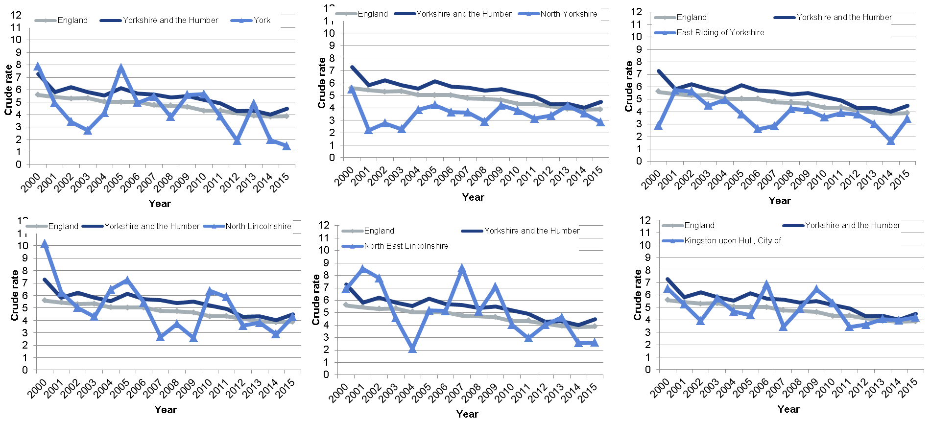
Appendix 1 – Infant mortality by local authority (1)

Slide 23
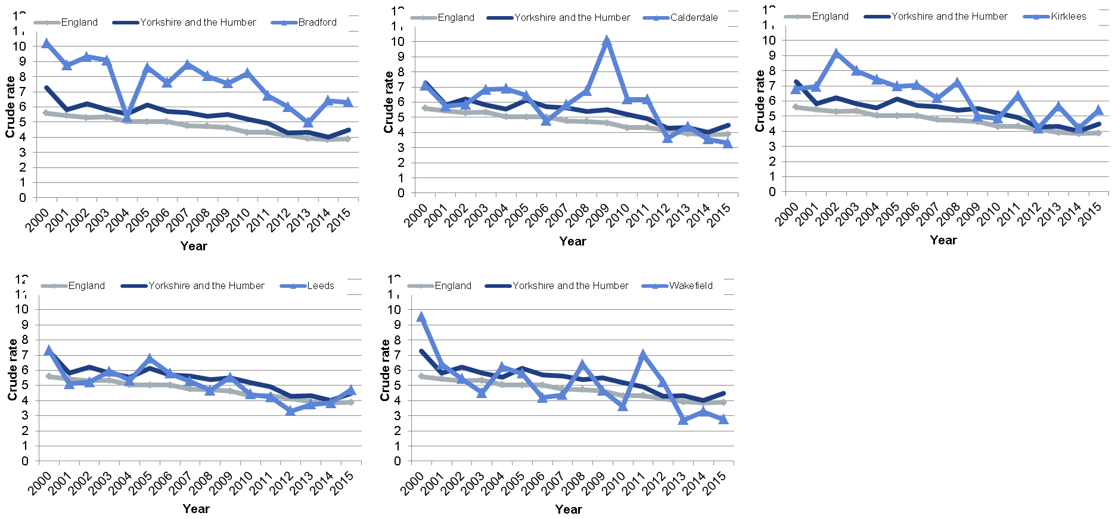
Infant mortality by local authority (2)

Slide 24
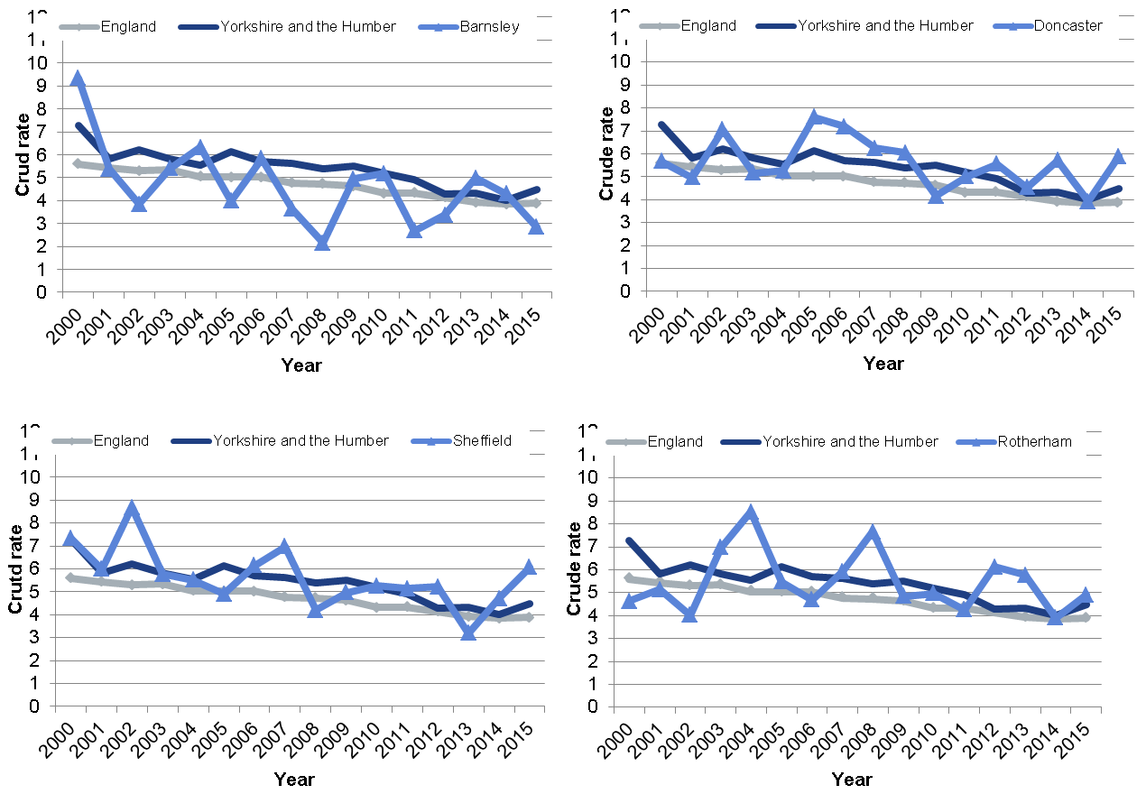
Infant mortality by local authority (3)

Slide 25
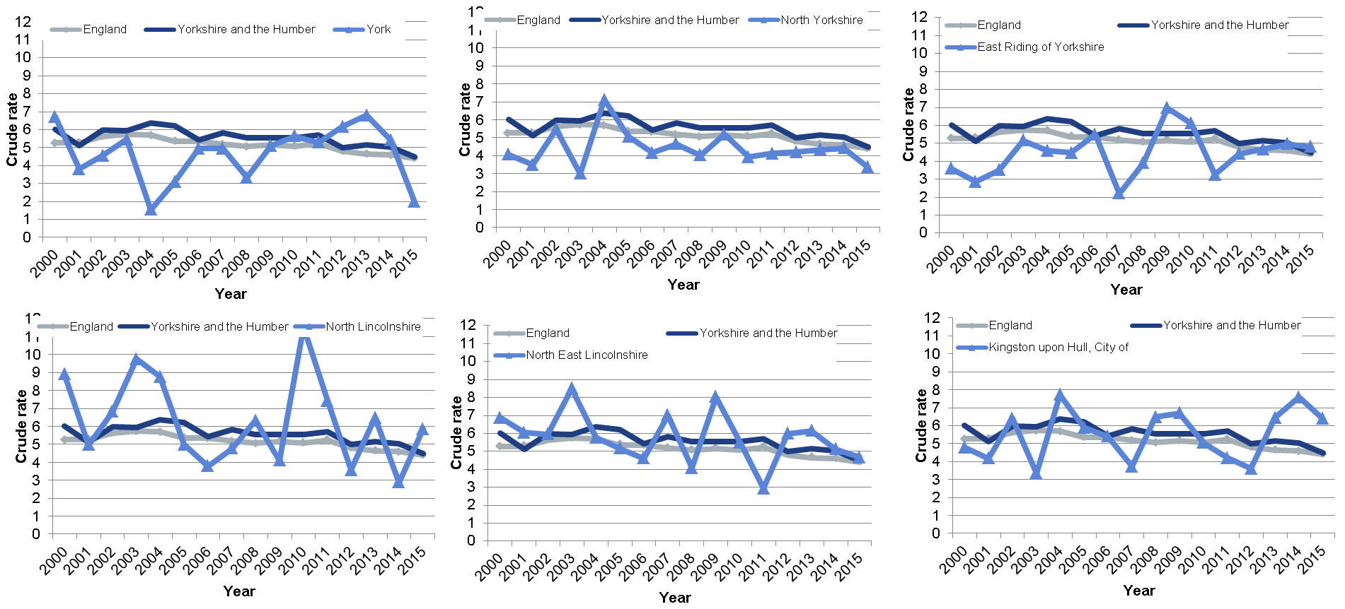
Appendix 2: Still births by local authority (1)

Slide 26
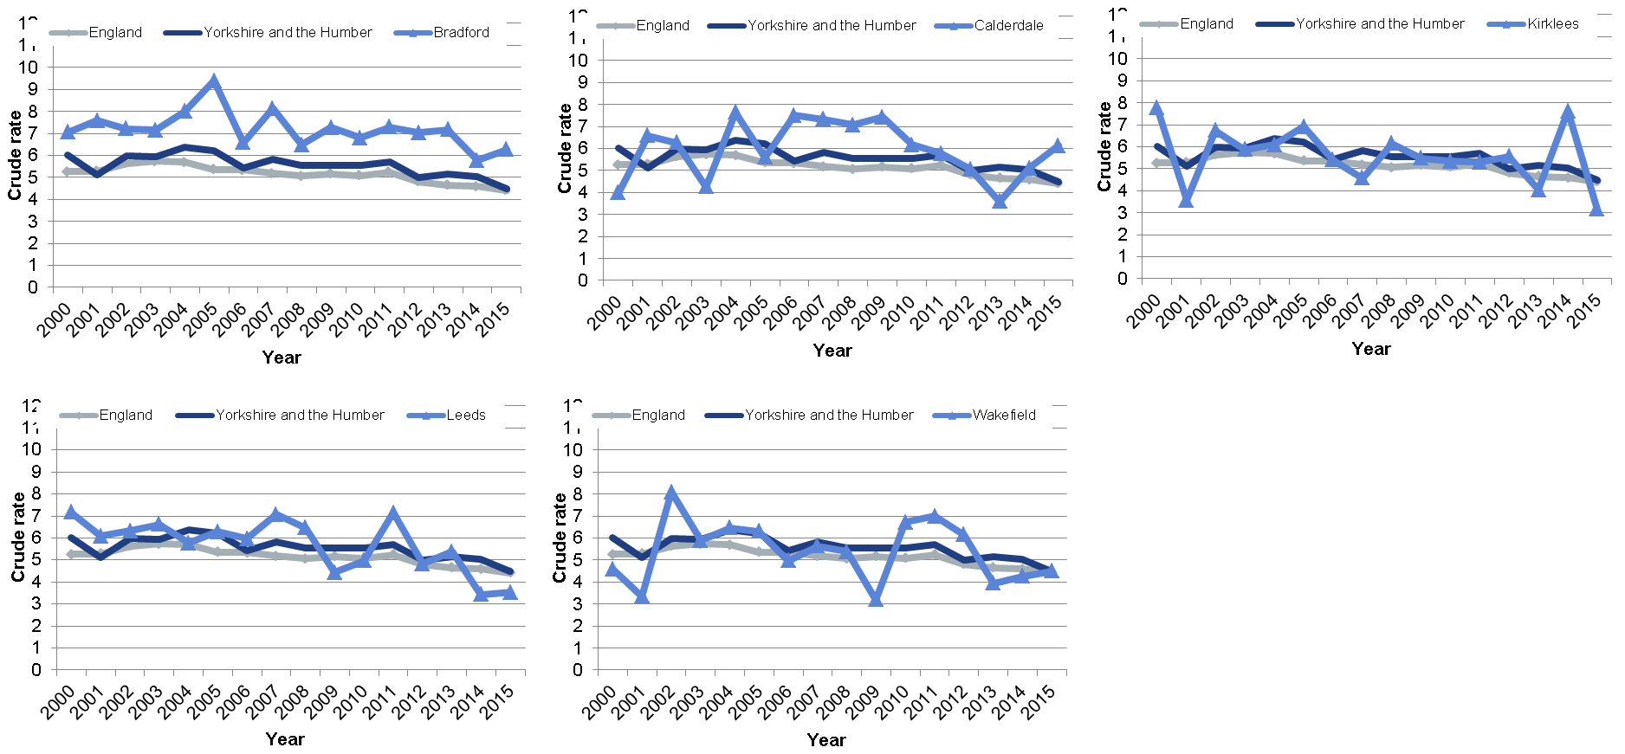
Still births by local authority (2)

Slide 27
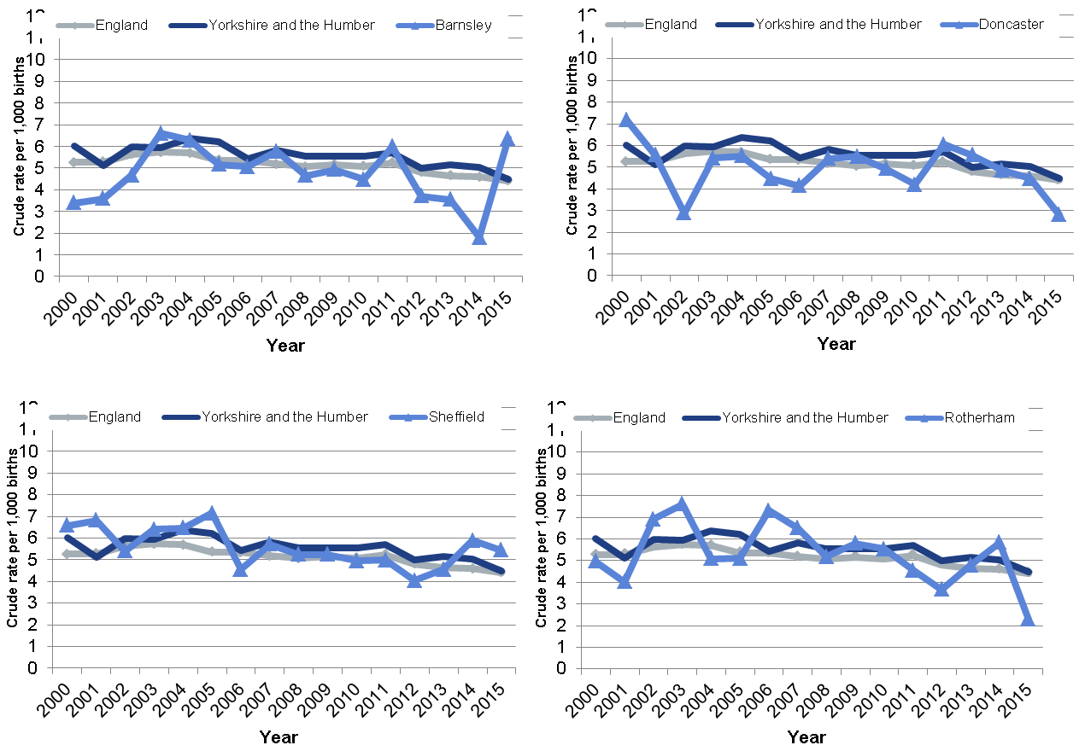
Still births by local authority (3)

Slide 28
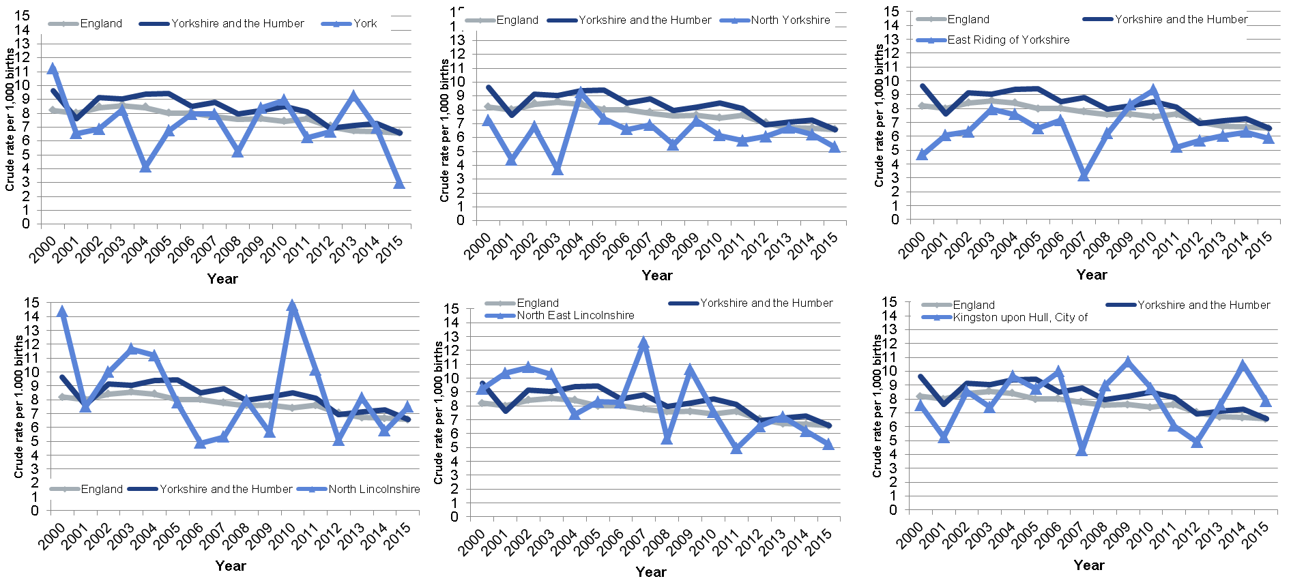
Appendix 3: Perinatal deaths by local authority (1)

Slide 29
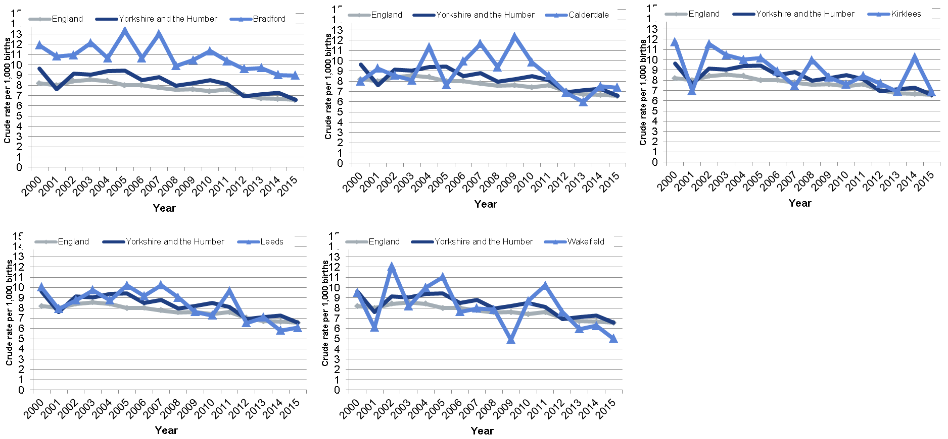
Perinatal deaths by local authority (2)

Slide 30
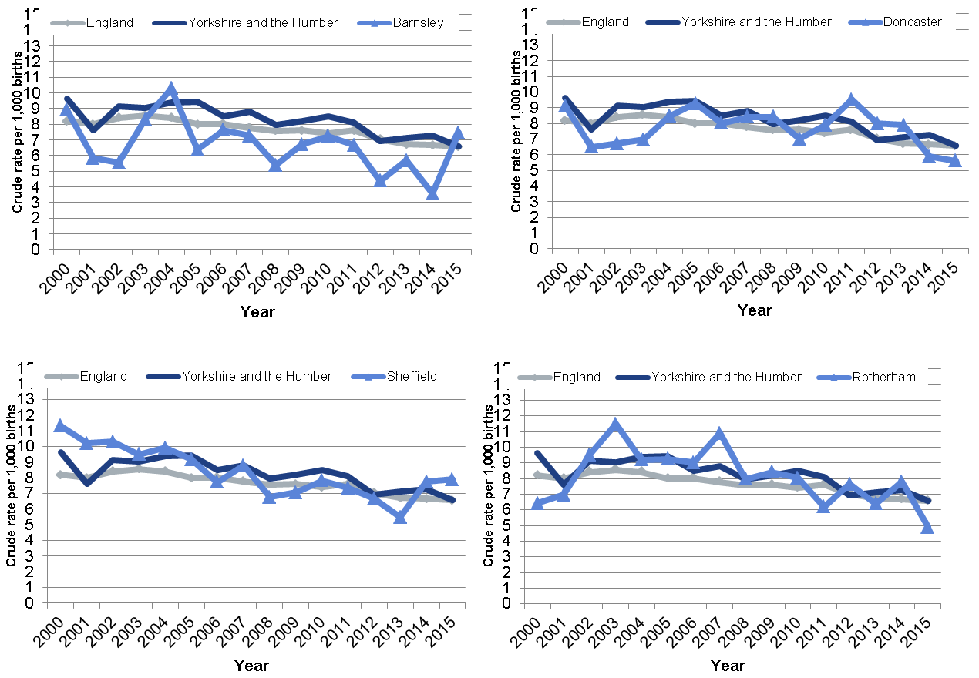
Perinatal deaths by local authority (3)

Slide 31
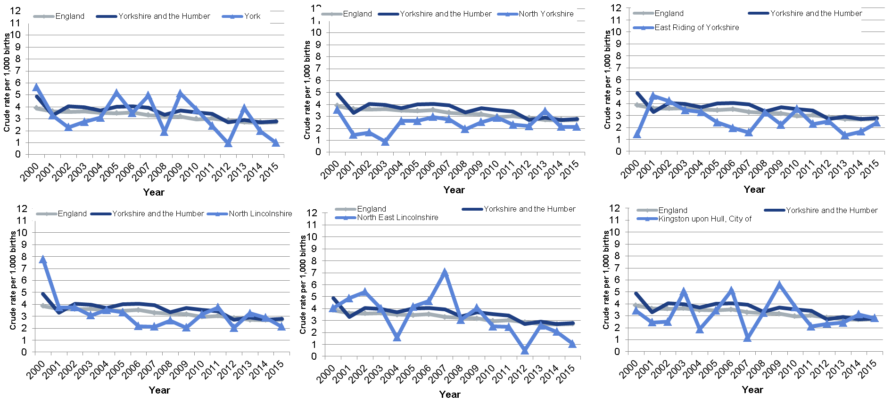
Appendix 4: Neonatal death rates by local authority (1)

Slide 32
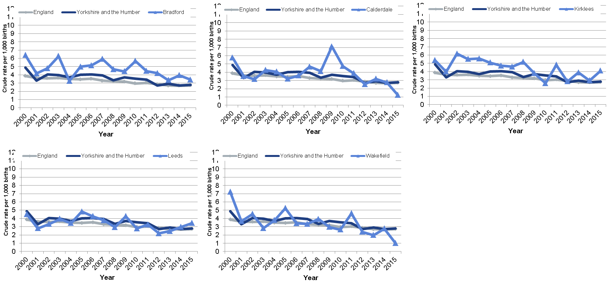
Neonatal death rates by local authority (2)

Slide 33
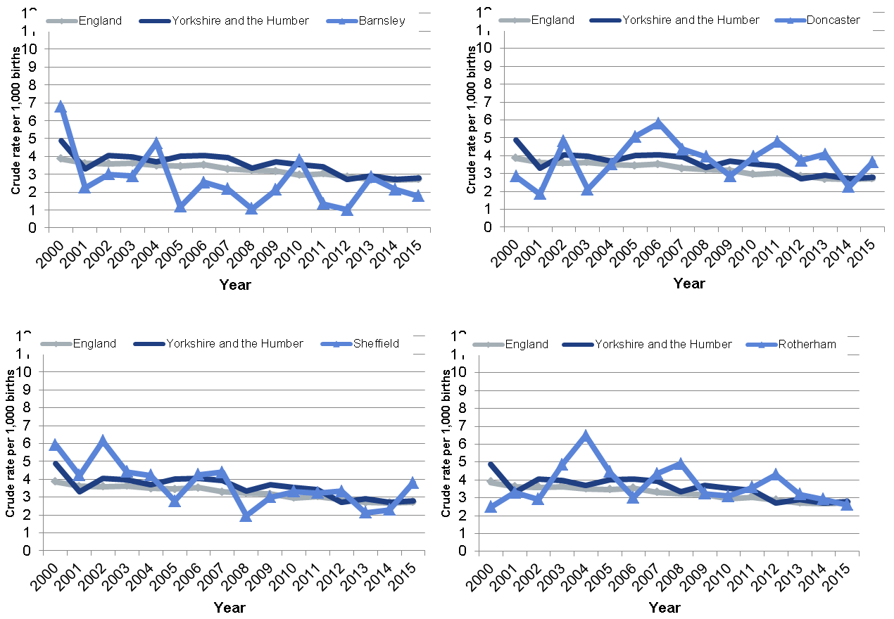
Neonatal death rates by local authority (3)

